Slide 1
The Application & Improvement of the Technique
Protein Synthesis

Slide 2
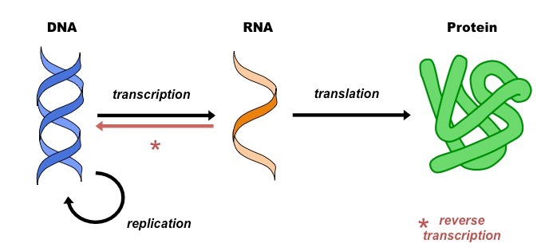
The Central Dogma of Molecular Biology

Slide 3
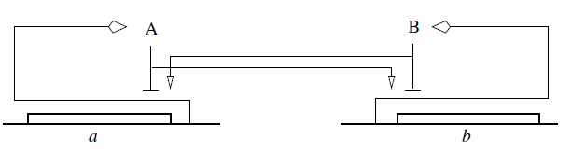
Gene Regulatory Network

Slide 4

Dynamics of the Gene Regulatory Network

Slide 5


Slide 6
Mannshardt Method

Slide 8
Assumption in the method
There is only one event in the interval
Several events , the interval would be squeezed to hold only one point of the discontinuity

Slide 9
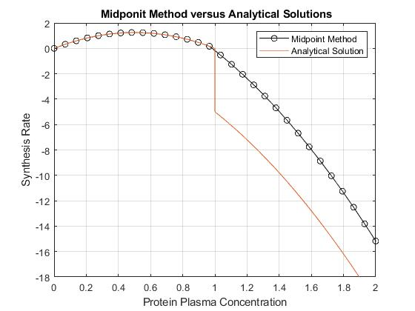
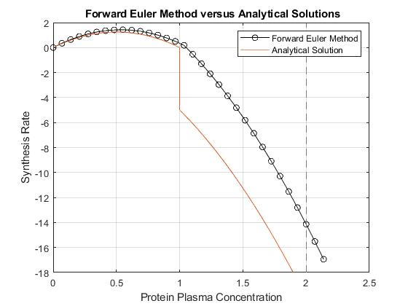
Numerical Solution with comparable Method
Midpoint
Forward Euler

Slide 10
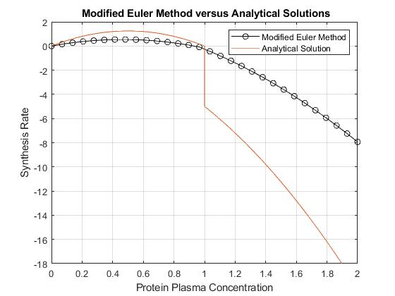
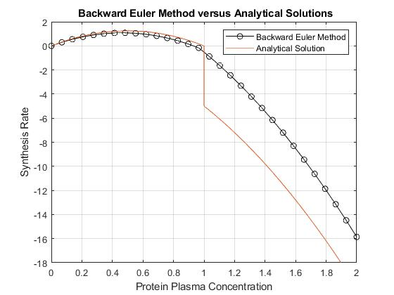
Modified Euler
Backward Euler

Slide 11
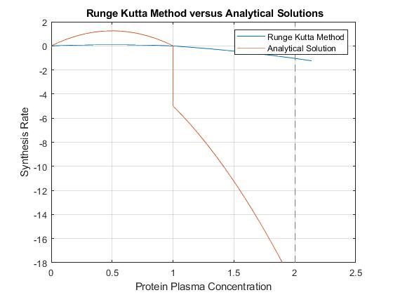
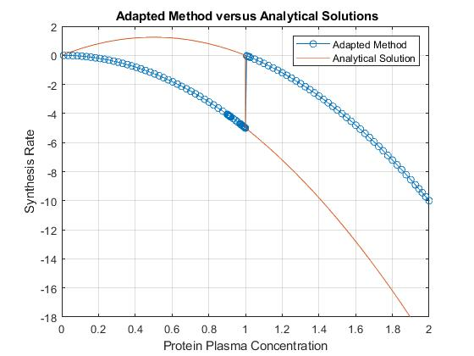
Runge Kutta Method
Mannshardt Method

Slide 12
Summary of the Methods
Numerical Method Employed | The Truncation Error
Midpoint | 23.37 %
Forward Euler Methods | 14.42 %
Modified Euler Methods | 59.94 %
Backward Euler Methods | 19.89 %
Runge Kutta Order 4 Methods | 93.06 %
Mannshardt Method | 49.49 %

